Slide 1
Software Engineering Lab
Building .NET Applications on the Oracle Database with Microsoft Visual Studio
Lab 1 – Connected Layer

Slide 2
Lab Rules
You MUST attend in your section.
Please commit to the lab start time.
No attendance exceptions from TAs.
Attendance exceptions only signed from doctors.

Slide 3
Agenda
Required installations
Introduction to ODP.Net
ODP.Net Object Model
DVD Rental Case Study
Running DB Script
Data Retrieval using OracleDataReader
Actors Form Design
Populating ComboBox with ActorIDs in the Form_Load

Slide 4
Required installations
Following Products are needed in order to build a VS.Net application on Oracle DB:
Oracle Database 11g
Microsoft Visual Studio.Net (Visual C#)

Slide 5
Introduction to ODP.Net
Oracle Data Provider for .NET (ODP.NET) provides fast and efficient ADO.NET data access from .NET client applications to Oracle databases.
Use ODP (from Oracle) instead of ADO (from Microsoft).
Note that the installation of Oracle Database includes Oracle Data Provider for .NET
Notes:
ADO.NET provides a relatively common way to interact with data sources, but comes in different sets of libraries for each way you can talk to a data source. These libraries are called Data Providers and are usually named for the protocol or data source type they allow you to interact with.. Found in System.Data.dll
Microsoft announces that System.Data.OracleClient namespace is deprecated.
The alternative is to use ODP (from Oracle) instead of ADO (from Microsoft).

Slide 6
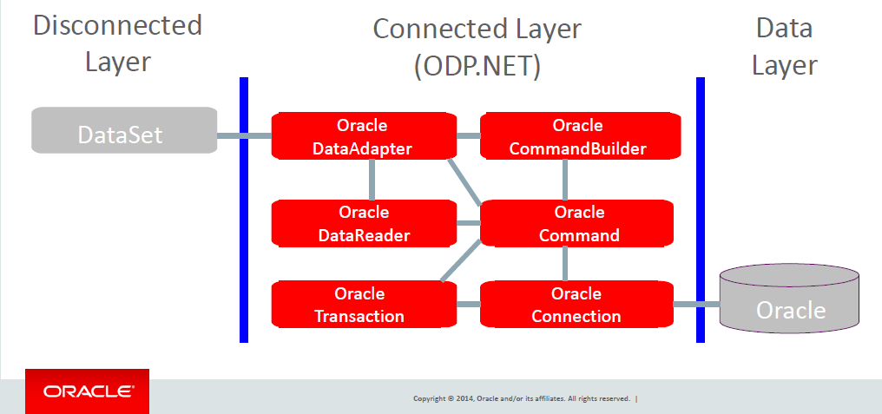
ODP.Net Object Model
Notes:
The Data Layer contains the Oracle DB
The connected layer contains the classes located in the ODP.Net data provider and are used for Direct communication with a database to handle data. These classes can be placed in two groups:
1- At one side
you have all the classes to set up a Connection, to handle a Command and to read the returned data (DataReader).
2- On the other side
you have a DataAdapter. This adapter implements all four sql commands (Select, Insert, Update and Delete).
With setting the sql code for a select (on a single table), the other three commands are automatically generated.
This DataAdapter is quite often used to supply large quantities of data to controls like GridView.
The disconnected layer can retrieve a DataSet from the connected classes. The Dataset is a class in VS.Net which acts like a database with set of tables (but then disconnected from the database.

Slide 7
DVD Rental Case Study
The following data model is designed to hold information related to a DVD rentals store.
The Tables required should include:
Members
Rentals
FilmCopies
FilmTitles
FilmCategory
FilmActors
Actors

Slide 8
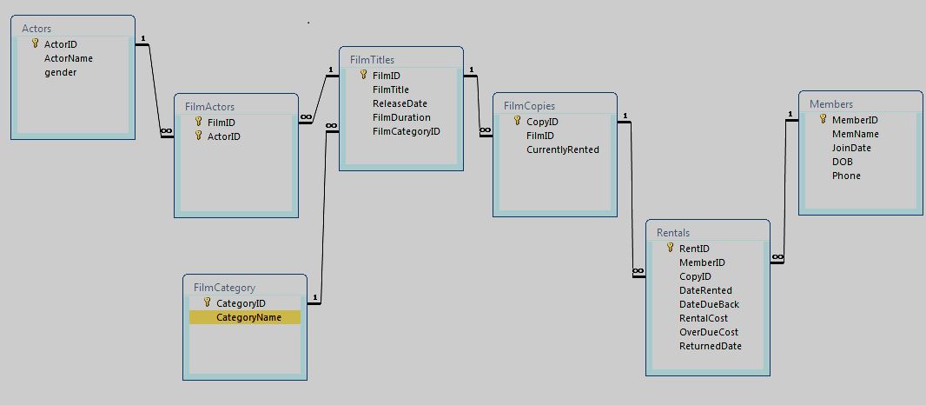
DB Design

Slide 9
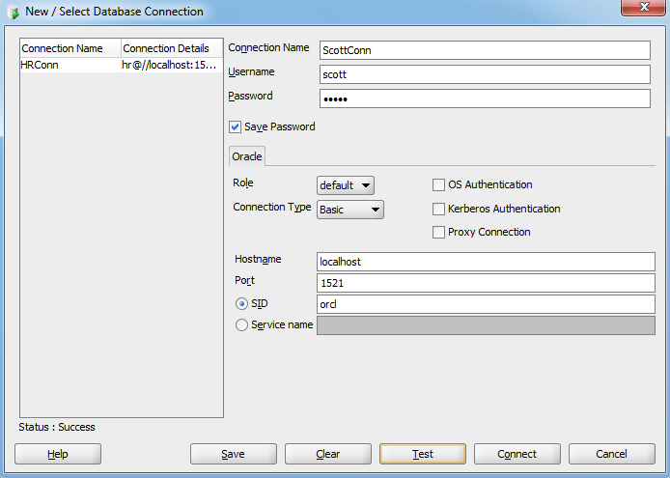
Running DB Script
Open SQL Developer
Create a new connection for scott user with the password tiger
Notes:
Before opening SQL Developer, make sure that all Oracle services are started
If you already have a connection for scott, then you can use it

Slide 10
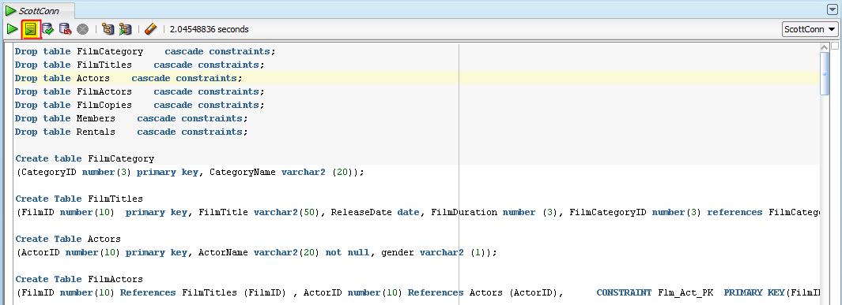
Running DB Script
Copy the DB script from “DVD rental Script” file, and paste it into the SQL Developer
Press “Run Script” button (or press F5)
Notes:
To get the DB script, refer to the “DVD rental Script.docx” file (delivered with the lab’s presentation)

Slide 11
Pre-requisites
Install Oracle 11g Database
Install Visual Studio.Net
Run the DVD Rental database creation script
You should be aware of all SQL statements (select, insert, update, delete)
Notes:
To install Oracle database, refer to “Installation - Database.pptx” (delivered with the lab’s presentation)
You need to be aware of all SQL statements

Slide 12
Connected Layer Actors form example

Slide 13
#Connecting to Oracle DB from C
Creating VS.Net C# project
Adding a Reference to Oracle library
Adding controls to the Form Design
Writing the code

Slide 14
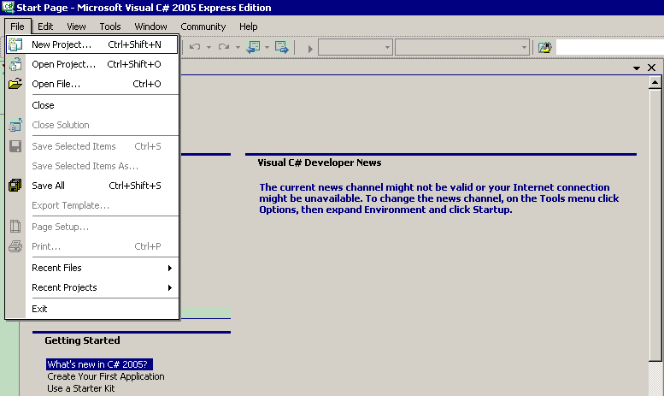
1- Creating VS.Net C# Project

Slide 15
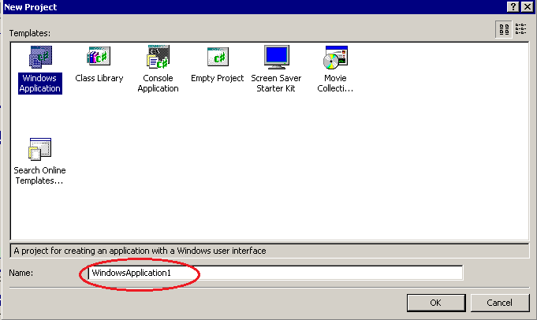
Creating VS.Net C# Project

Slide 16
2- Adding a Reference
To connect the project to an Oracle database, you must add a reference to the Oracle.DataAccess.dll, which contains the data provider.
This library is located at:
E:\app\pc_user\product\11.2.0\dbhome_1\ODP.NET\bin\2.x
Notes:
Note:
E: is the drive which oracle database is installed on it
pc_user: is the user name on your computer (it is different from pc to another)

Slide 17
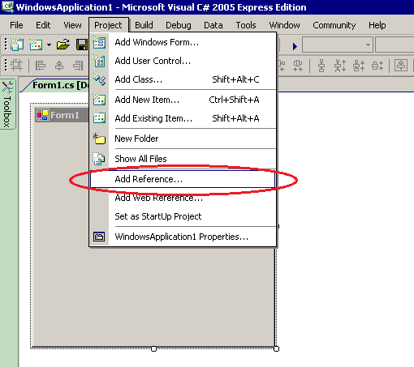
2- Adding a Reference (Cont.)

Slide 18
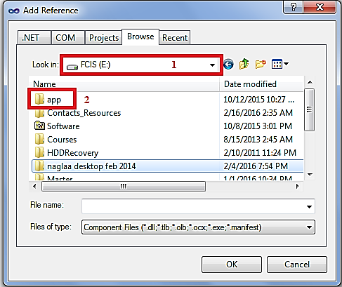
2- Adding a Reference (Cont.)
E:\app\pc_user\product\11.2.0\dbhome_1\ODP.NET\bin\2.x
Notes:
Select the drive on which you installed oracle database (in this example E: )
Then follow the path shown in the slide above

Slide 19
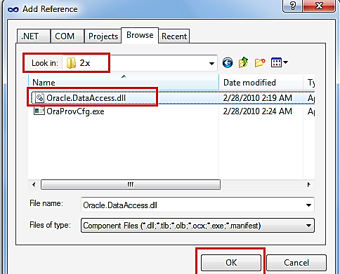
2- Adding a Reference (Cont.)

Slide 20
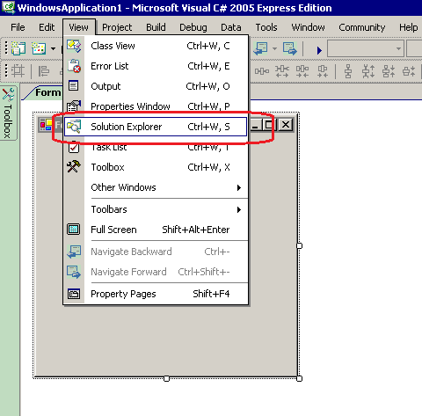
2- Adding a Reference (Cont.)
Notes:
View Solution Explorer to find the components of your project (libraries, classes, Forms..)

Slide 21
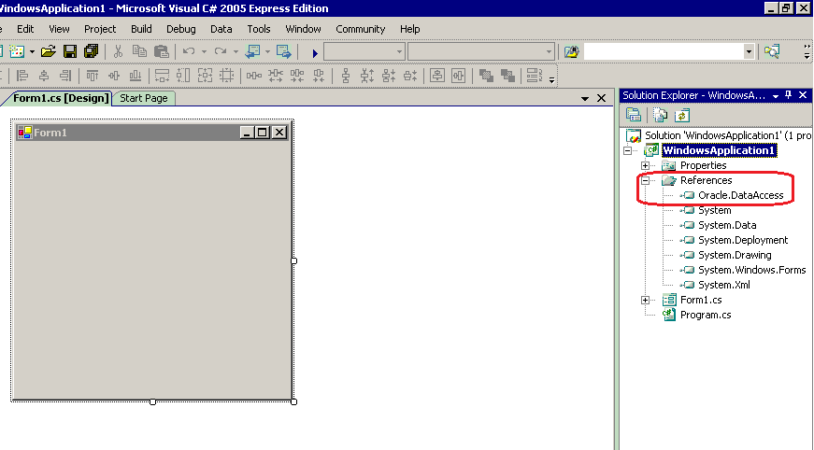
2- Adding a Reference (Cont.)

Slide 22
Oracle.DataAccess.dll Library
The Oracle.DataAccess.dll provides two namespaces:
The Oracle.DataAccess.Client namespace contains ODP.NET classes and enumerations for the client-side provider.
The Oracle.DataAccess.Types namespace contains the Oracle Data Provider for .NET data types (ODP.NET Types).

Slide 23
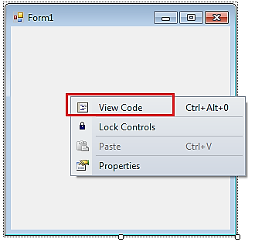
Adding Initial C# Statements
Notes:
// Right click on the form to view code then type the following:
using Oracle.DataAccess.Client;
using Oracle.DataAccess.Types;

Slide 24
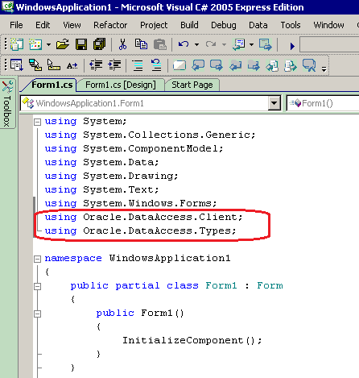
Adding Initial C# Statements
Notes:
// Right click on the form to view code then type the following:
using Oracle.DataAccess.Client;
using Oracle.DataAccess.Types;

Slide 25
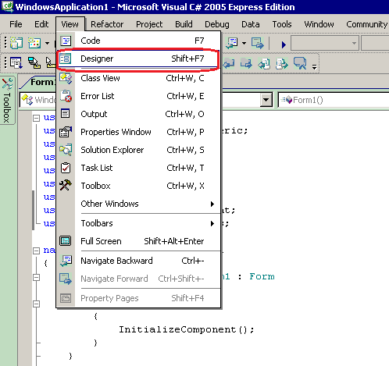
3- Adding controls to the Form Design
Notes:
To go back to the form in designer, either from the view menu, or simply click on the tab “Form1.cs [design])

Slide 26
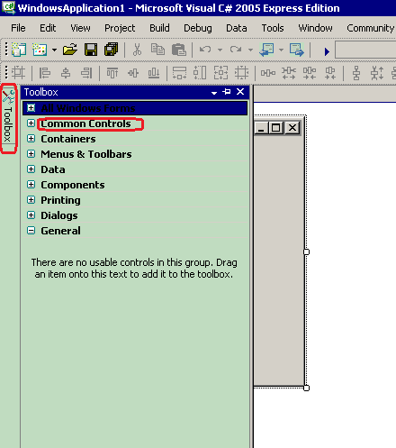
3- Adding controls to the Form Design (Cont.)

Slide 27

3- Adding controls to the Form Design (Cont.)

Slide 28
Writing the code
Creating OracleConnection object
Creating OracleCommand object
Connection
Command text
Command Type
Parameters
Execute command
Closing the connection (after executing all commands)

Slide 29
1- Form Preparation a. Fill Actors IDs (Select Statement)

Slide 30
Creating Oracle Connection Object
The OracleConnection object specifies the Oracle Database used by the application.
Define the global variables
string ordb = "Data source=orcl;User Id=scott; Password=tiger;";
OracleConnection conn;
Then open the connection
conn = new OracleConnection(ordb) ;
conn.Open();

Slide 31
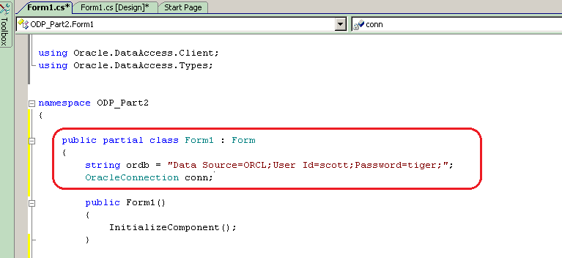
Declaring Global Connection Object
Notes:
The Connection object and its connection string is declared GLOBAL so that it could be used inside any other function/event inside that class

Slide 32
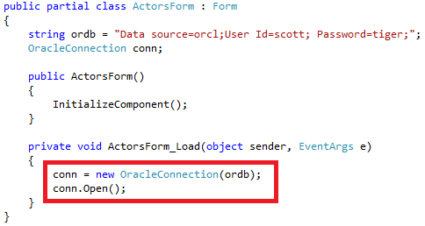
Creating Connection Object(Cont.) Form_Load event
Notes:
The connection object is created and Opened in the form Load before any db transaction takes place (before select/update/delete…)
You need to open it only once, and it will be seen opened wherever you reference it in this form (cause it is globally declared)

Slide 33
Creating OracleCommand object
The command object is used to specify the SQL command text that is executed, either a SQL string or a stored procedure.
It creates a database request, sends the request to the database, and returns the result.

Slide 34
Creating OracleCommand object (Cont.)
To create OracleCommand Object, write this code in the Form_load event handler:
OracleCommand cmd = new OracleCommand();
cmd.Connection = conn;
cmd.CommandText = "select ActorID from Actors";
cmd.CommandType = CommandType.Text;
Notes:
Connection: This property specifies the OracleConnection object that is used to identify the connection to execute a command.
CommandText: This property specifies the SQL statement or stored procedure to run against the Oracle database.
CommandType: This property specifies the command type that indicates how the CommandText property is to be interpreted (either sql statement or stored procedure)

Slide 35
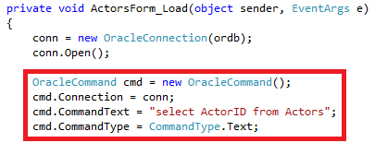
Creating OracleCommand object (Cont.)

Slide 36
Using OracleDataReader to retrieve data
An OracleDataReader object represents a forward-only, read-only, in-memory result set.
Unlike the DataSet, the OracleDataReader object stays connected and fetches one row at a time.

Slide 37
Using OracleDataReader to retrieve data (Cont.)
An OracleDataReader object is constructed by a call to the ExecuteReader method of the OracleCommand object.
To retrieve data from DB, write this code:
OracleDataReader dr = cmd.ExecuteReader();
while (dr.Read())
{
cmb_ID.Items.Add(dr[0]);
}
dr.Close();

Slide 38
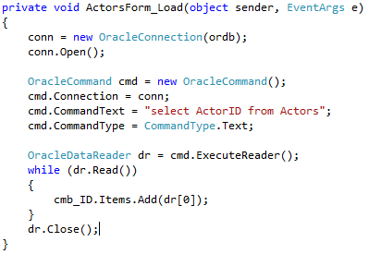
Using OracleDataReader to retrieve data (Cont.)
Notes:
conn = new OracleConnection(ordb);
conn.Open();
OracleCommand cmd = new OracleCommand();
cmd.Connection = conn;
cmd.CommandText = "select ActorID from Actors";
cmd.CommandType = CommandType.Text;
OracleDataReader dr = cmd.ExecuteReader();
while (dr.Read())
{
cmb_ID.Items.Add(dr[0]);
}
dr.Close();

Slide 39
Using OracleDataReader to retrieve data (Cont.)
ExecuteReader:
This method executes a command specified in the CommandText and returns an OracleDataReader object.
Read():
This method reads the next row in the result set.
To return multiple rows, use loop
The initial position of the data reader is before the first row. Therefore, the Read method must be called to fetch the first row.
The row that was just read is considered the current row. If the OracleDataReader has no more rows to read, it returns false.

Slide 40
Using OracleDataReader to retrieve data (Cont.)
Columns in result set
Access columns in result set using their indexes (dr[ColumnIndex]) or names (dr[“ColumnName”])
ColumnIndex is Zero-based column index.
Close():
This method closes the OracleDataReader and frees all resources associated with the OracleDataReader.

Slide 41
Closing the connection
Either the connection object's Close or the Dispose method should be called to close the connection to the database. The Dispose method calls the Close method implicitly.
Free up system resources
More efficient application performance, which is especially important under high load conditions.

Slide 42
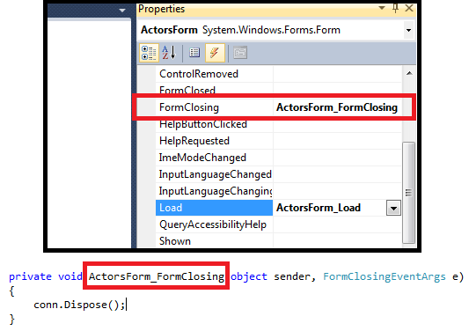
Closing the connection (Cont.)

Slide 43
Thank You

